Slide 1
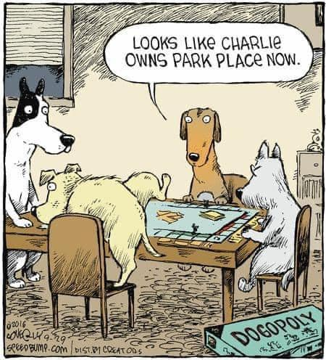
Oligopoly and Game Theory
Module 7
Management 405
Prof. Nico Voigtländer · UCLA Anderson

Slide 2
Module 7 · Recap
Lessons from Module 6: Complex Pricing
Price discrimination: different customers
First degree (perfect discrimination)
Third degree: segmentation
Higher price to less elastic groups
Second degree (indirect): versioning
Volume pricing: same consumer, multiple units
Unlimited access fee if MC=0 (e.g., Netflix)
Fee = all the area under the demand curve
Two-part pricing when MC>0 (e.g., Starbucks)
Per-unit fee = MC
Flat fee = area under the demand curve above the per-unit fee
Both can be computed directly from the demand function
Management 405 · Module 7 · Oligopoly and Game Theory
2

Slide 3
Module 7 · Course Roadmap
Agenda for the Class
1. The Economic Way of Thinking
2. Value and Demand
3. Supply and Cost
4. Markets, Pricing and Strategy
we are here
Management 405 · Module 7 · Oligopoly and Game Theory
3
Notes:
This is where Module 7 sits in the 405 course as a whole. We built the economic way of thinking, then demand, then supply and cost. Module 7 continues part 4: markets, pricing, and strategy — moving from monopoly and monopolistic competition to oligopoly, where a few firms interact strategically, and to game theory, the toolkit for analyzing that interaction.

Slide 4
Module 7 · Outline
Outline of Module 7
1
Collusion and Cartels
Why firms are tempted to collude, and why cartels break down
2
Cournot Competition
Competing by choosing quantities: capacity decisions in oligopoly
3
Bertrand Competition
Competing by setting prices, and why it can compete profits away
4
Oligopoly with Differentiated Goods
How differentiation softens price competition
5
Strategic Thinking: Key Concepts
Best responses, dominant strategies, and Nash equilibrium
6
Prisoner’s Dilemma, Game of Chicken…
Classic games and what they teach about business strategy
Management 405 · Module 7 · Oligopoly and Game Theory
4

Slide 5
Module 7 · Concept Map
How the Pieces of Module 7 Connect
OLIGOPOLY (Part 1)
GAME THEORY (Part 2)
Oligopoly few large firms — each firm's best move depends on its rivals'
Game Theory the toolkit for strategic interaction
Collusion / Cartel act jointly as a monopolist profitable, but unstable (and illegal)
Cournot compete on quantities price between monopoly and competition
Bertrand compete on prices identical goods: P = MC differentiated goods: P > MC
Dominant strategy best no matter what the rival does (Prisoner's Dilemma)
Nash equilibrium individually best responses ⇒ no player wants to deviate
Commitment bind yourself to change the game (M.A.D., entry deterrence)
Cournot & Bertrand are games: their equilibria are Nash equilibria
MB = MC
(given the rival's action)
Management 405 · Module 7 · Oligopoly and Game Theory
5
Notes:
The map of Module 7 before we dive in. Part 1 is oligopoly — few large firms whose best moves depend on each other — in three flavors: collusion (act jointly as a monopolist, profitable but unstable and illegal), Cournot competition on quantities, and Bertrand competition on prices. Part 2 is game theory, the general toolkit behind all of this: dominant strategies, Nash equilibrium, and commitment. The gold bridge is the punchline connecting the two halves: Cournot and Bertrand are themselves games, and their equilibria are Nash equilibria. We return to this map as the module unfolds.

Slide 6
Module 7 · Part 1 · Oligopoly
The Four Basic Market Structures
 | Perfect competition | Monopolistic competition | Oligopoly | Monopoly
Number of Firms | Many | Many | Few | One
Type of Products Sold | Identical | Differentiated | Identical or Differentiated | Unique
Barriers to Entry | None | None | Some | Many
Management 405 · Module 7 · Oligopoly and Game Theory
6

Slide 7
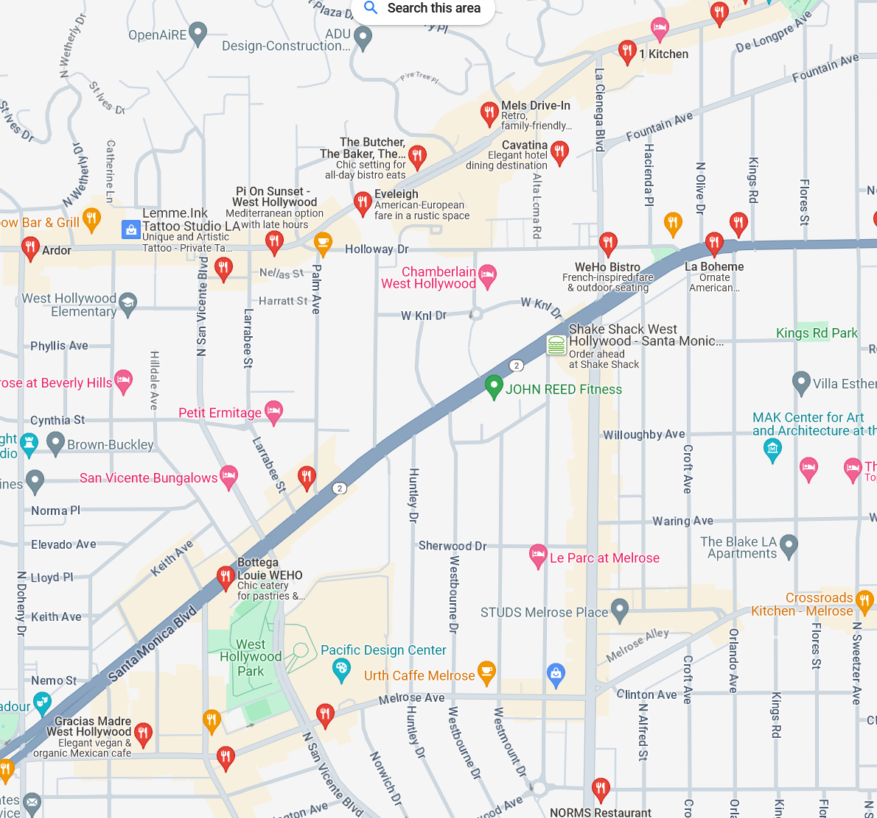
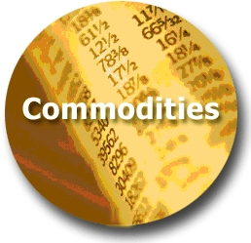



Module 7 · Part 1 · Oligopoly
Where We Are and Where We Are Going
WE ARE HERE
Least Market Power
Most Market Power
Perfect
Monopolistic
Oligopoly
Monopoly
Competition
Competition
(Price Takers)
(Price Searchers)
Restaurants in WeHo
Management 405 · Module 7 · Oligopoly and Game Theory
7

Slide 8
Module 7 · Part 1 · Oligopoly
Market Structure Characteristics
 | Oligopoly
Number of actual or potential competitors | Few enough sellers so that their decisions are interdependent
Product differentiation | High or low
Entry conditions | High barriers due to economies of scale, capital requirements, access
Profit potential | Economic profit can be positive in short/long run
Examples | Cell phone providers; soft drinks; tobacco; semiconductors; wide-bodied aircraft
Management 405 · Module 7 · Oligopoly and Game Theory
8
Notes:
Oligopoly means markets with few sellers, but more than one (which is monopoly). How few? What is the distinction between oligopoly and monopolistic competition?
There are barriers to entry in oligopolistic markets, keeping the number of competitors low and creating the potential for long term abnormal profits.
There is strategic interdependence in oligopoly: under monopolistic competition, each firm ignores price changes by other firms because each is so small their price behavior does not affect your behavior. Under oligopoly, each has an incentive to respond to others' deviations.
Examples of oligopoly include tobacco, satellite radio (before the merger), wide-bodied aircraft, and mobile phone services.

Slide 9





Module 7 · Part 1 · Oligopoly
Measuring Market Concentration
When do we have an oligopoly?
Simple measure: Concentration Ratio CR4
Market share of the four largest firms
Oligopoly if CR4 > 66%
Example: US wireless carriers — top 3 ≈ 97%
Limitations of these measures
Definition of relevant market
Role of potential competition
US wireless subscribers, late 2025 (millions)
146
140
119
Verizon
T-Mobile
AT&T
Source: company reports (retail connections)
Mergers: T-Mobile absorbed Sprint (2020) and UScellular (2025)
+
+
Management 405 · Module 7 · Oligopoly and Game Theory
9
Notes:
Example: concentration in US mobile phone services — clearly an oligopoly. Verizon, T-Mobile, and AT&T together serve roughly 97% of retail wireless subscribers. And consolidation continues: T-Mobile absorbed Sprint in 2020 and UScellular's wireless operations in August 2025.

Slide 10
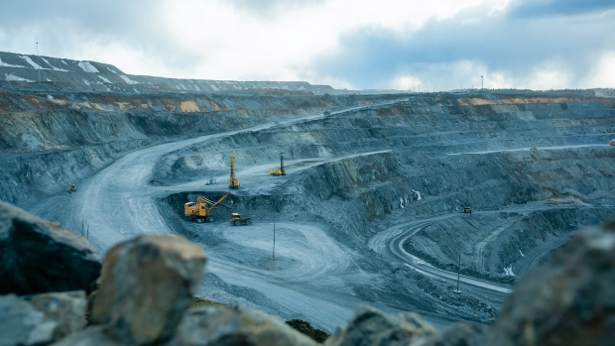
Module 7 · Part 1 · Oligopoly
Oligopoly Example: Nickel Mining
Homogeneous good
Key input for batteries (electric vehicles…)
Two dominant producers – our duopoly example
Vale (Brazil)
Tsingshan Holding (China) – mines mainly in Indonesia
A few other, smaller producers in different countries
Will use this as guiding example
Note: Norilsk Nickel (Russia) is also a major producer – we exclude it here because of the sanctions against Russia
Management 405 · Module 7 · Oligopoly and Game Theory
10
Notes:
Nickel is our guiding example for oligopoly: a homogeneous commodity, and a key input for nickel-rich EV batteries. We stylize the market as a duopoly with the two dominant producers: Vale of Brazil, the largest Western producer, and China's Tsingshan Holding, the world's largest nickel producer, which mines mainly in Indonesia — Indonesia now accounts for roughly two-thirds of world mine production (USGS 2026), and Tsingshan alone for roughly 30%. Norilsk Nickel of Russia is also a major producer, but we exclude it here because of the sanctions against Russia. Background on the nickel market: https://www.nsenergybusiness.com/features/top-nickel-producing-companies/

Slide 11
Module 7 · Part 1 · Collusion and Cartels
Outline of Module 7
1
Collusion and Cartels
Why firms are tempted to collude, and why cartels break down
2
Cournot Competition
3
Bertrand Competition
4
Oligopoly with Differentiated Goods
5
Strategic Thinking: Key Concepts
6
Prisoner’s Dilemma, Game of Chicken…
Management 405 · Module 7 · Oligopoly and Game Theory
11

Slide 12
Module 7 · Part 1 · Collusion and Cartels
Collusion
Definition of Collusion
Firms in an oligopoly coordinate their production and pricing decisions
▪ Aim: collectively act as a monopolist to gain monopoly profits
▪ Profits to be split among the participating firms
▪ Extreme case – a cartel: an explicit, organized price-fixing agreement (e.g., OPEC)
“People of the same trade seldom meet together, even for merriment and diversion, but … in some contrivance to raise prices.”
— Adam Smith (1723–1790)
Management 405 · Module 7 · Oligopoly and Game Theory
12

Slide 13
Module 7 · Part 1 · Collusion and Cartels
Cartels
Individual Sellers
P
P
Group/Industry
LMC
Profit with cartel
Extra Profit when deviating
LAC
$$P_{Cartel}$$
$$P_{Cartel}$$
S
$$P_{Comp}$$
d
$$P_{Comp}$$
Zero profit under competition
MR
D
$$q_{Cartel}$$
$$q_{Comp}$$
$$q_{Dev}$$
q
$$Q_{Cartel}$$
$$Q_{C}$$
Q
A monopolist in the market would produce Q_{cartel} , and this reduced output leads to a higher market price P_{Cartel}
For the cartel to work, each firm must produce q_{Cartel} (that is, each firm must reduce its output)
At the cartel price, each firm would like to deviate and produce more (q_{Dev}, where P_{cartel} = LMC)
Management 405 · Module 7 · Oligopoly and Game Theory
13
Notes:
Left panel: the individual cartel member. Under competition the firm earns zero profit at the LAC minimum. At the cartel price P_Cartel, producing its quota q_Cartel earns the cartel profit — but at that price the firm would privately like to expand to q_Dev, where the price equals its marginal cost LMC, pocketing the extra profit from deviating. That temptation is why cartels are unstable.
Right panel: the industry. Acting like a monopolist, the cartel restricts total output to Q_Cartel (where MR crosses the supply/MC curve) and the price rises above the competitive level at Q_C.

Slide 14

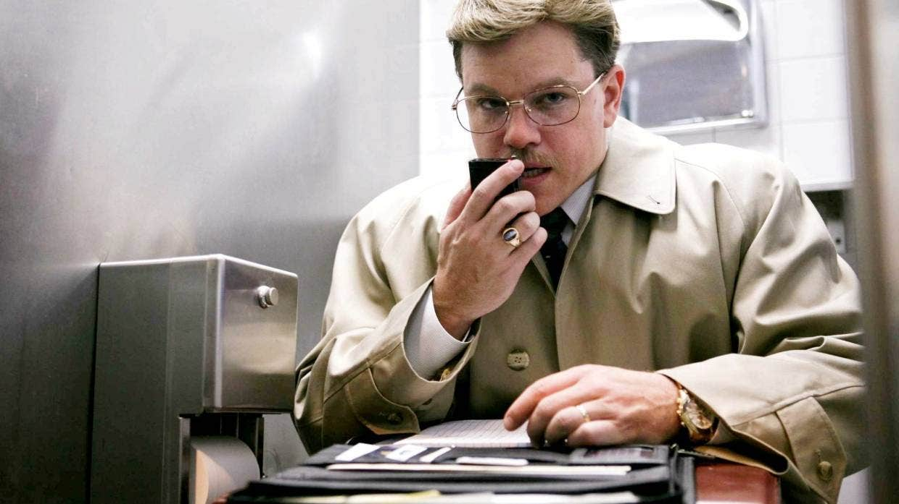
Module 7 · Part 1 · Collusion and Cartels
Collusion: The Case of ADM
Archer Daniels Midland (ADM) involved in organized effort to raise the price of the animal feed additive lysine
Unique case with FBI mole
Taped price-fixing meetings
Original FBI footage on course webpage (under Module 7 In-Class Content)
Podcast, Movie, Related Podcast: The Poop Cartel
Matt Damon in “The Informant!” (2009)
Management 405 · Module 7 · Oligopoly and Game Theory
14
Notes:
International Price Fixing. It harms consumers, and it is hard to prove price co-movements are indeed due to collusion.
Mark Whitacre, the FBI mole at ADM, recorded the price fixing meetings. Mention special role of golf on Hawaii.
FBI Video: Jump to 2:00. Tyson and ConAgra: major food producers, customers buying lysine: those that would be most hurt by price fixing. Actual price fixing at 7:20 – at some point, they even check the FX rate with the Canadian dollar to fix the price in a billion-dollar market within a minute.
From the Poop Cartel Podcast: “Poop is big business in Dakar, Senegal. That's because a lot of the homes have septic tanks, which need to be cleaned out regularly. The best way to clean your tank is by hiring a proper truck, which arrives with a vacuum. The problem is that for years, the guys who drove the poop trucks operated as a cartel, and they squashed competition and kept prices high. So a lot of people turned to a cheaper alternative: men who clear out septic tanks by hand, with shovels and buckets, and basically bury the poop in the street. It's terrible work and bad for the environment. Today on the show: how economists got sewage off the streets of Dakar by making poop-truck drivers compete with each other. In other words, by breaking up the poop cartel.”

Slide 15
Module 7 · Part 1 · Collusion and Cartels
The ADM Price-Fixing Scandal
[ copy video over by hand (not done yet to keep file size manageable) ]
Management 405 · Module 7 · Oligopoly and Game Theory
15

Slide 16
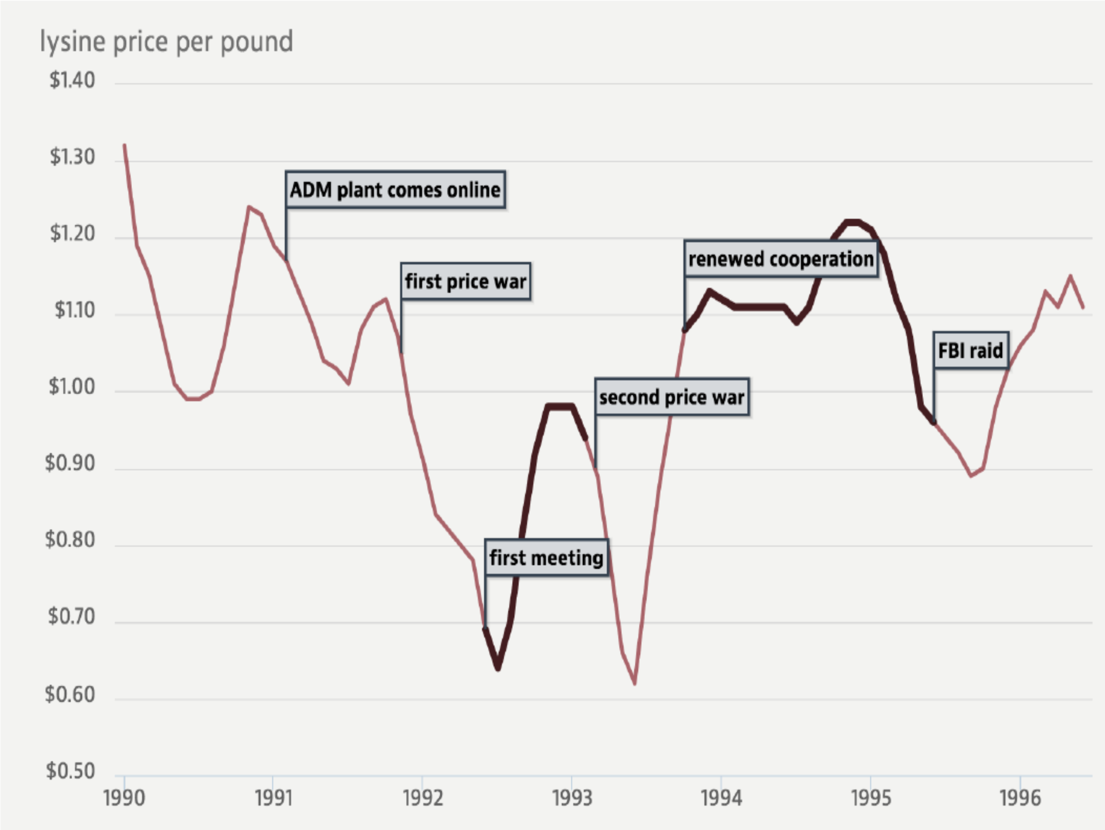
Module 7 · Part 1 · Collusion and Cartels
The ADM Price-Fixing Scandal
Source: American Economic Association, “Conspiracies against the public” (aeaweb.org)
Management 405 · Module 7 · Oligopoly and Game Theory
16
Notes:
The lysine price per pound around the ADM cartel: prices fall during the price wars, rise when the conspirators meet and cooperate, and collapse again after the FBI raid. Source: https://www.aeaweb.org/research/conspiracies-against-the-public

Slide 17
Module 7 · Part 1 · Cournot Competition
Outline of Module 7
1
Collusion and Cartels
2
Cournot Competition
Competing by choosing quantities: capacity decisions in oligopoly
3
Bertrand Competition
4
Oligopoly with Differentiated Goods
5
Strategic Thinking: Key Concepts
6
Prisoner’s Dilemma, Game of Chicken…
Management 405 · Module 7 · Oligopoly and Game Theory
17

Slide 18
Module 7 · Part 1 · Cournot Competition
Note
From now on:
No collusion among competitors
→ Firms compete strategically (“games”)
Management 405 · Module 7 · Oligopoly and Game Theory
18

Slide 19
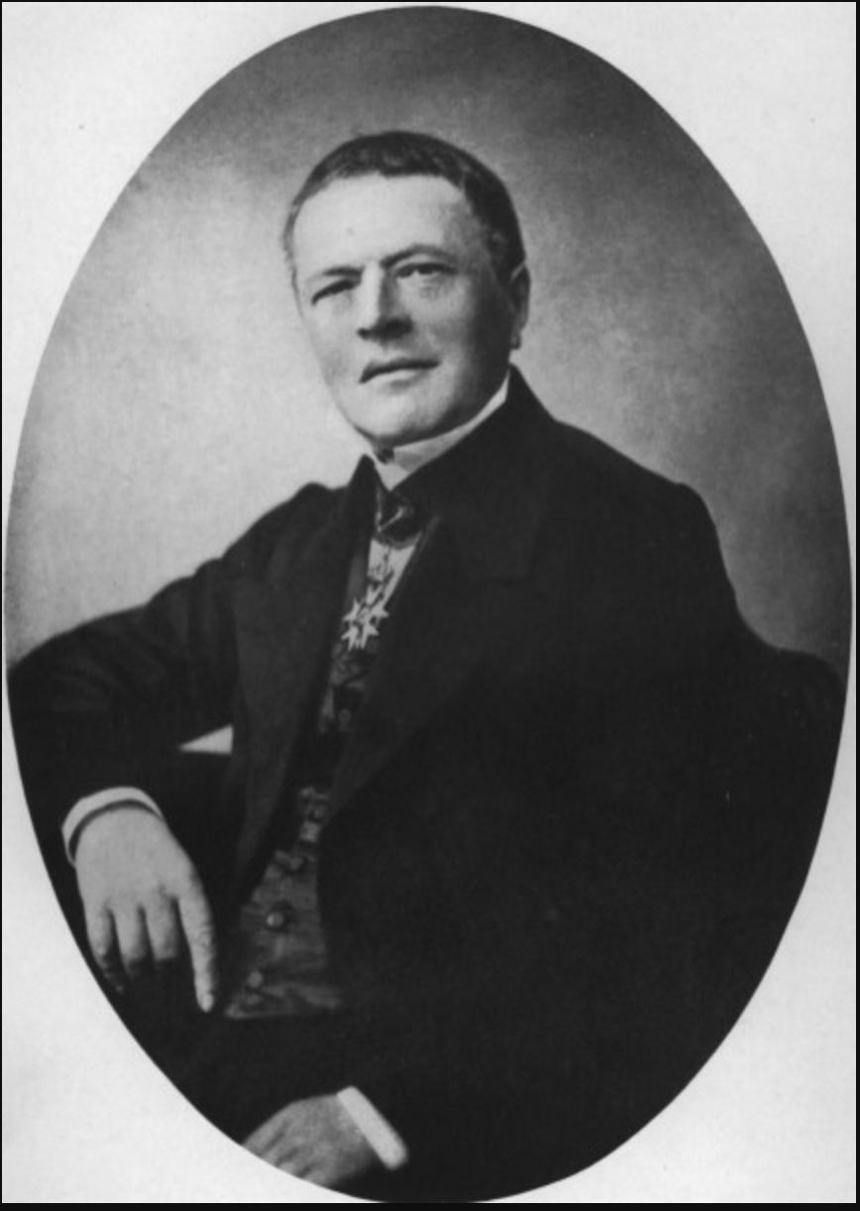
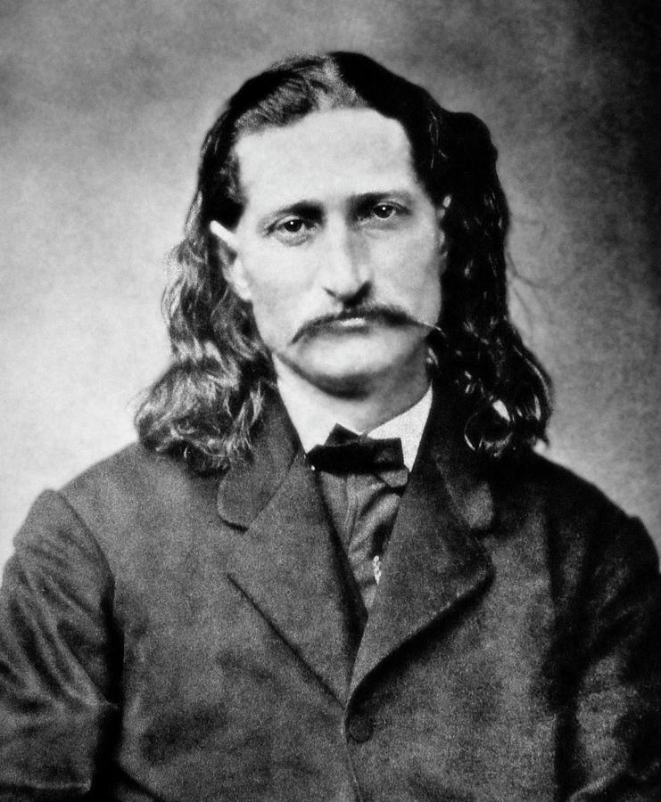
Module 7 · Part 1 · Cournot Competition
Two Models of Oligopoly Competition
Cournot (1801–1877)
Bertrand (1822–1900)
Cournot Model: Competition in Quantity
Bertrand Model: Competition in Price
Management 405 · Module 7 · Oligopoly and Game Theory
19
Notes:
Oligopoly: Cournot versus Bertrand. In what follows we will assume no collusion: competition rather than cooperation between firms. There are a lot of models of oligopoly – as many as assumptions you are willing to make on rivals' responses. You will come back to these issues in your strategy class, for now we give the foundations that will be used in strategy.
Two oligopoly models – the two most famous ones.
Cournot assumed quantity competition: each firm sets quantity taking as fixed the quantity set by the other. The assumption is that the other firm will continue to produce the same quantity whatever I do. As we will see shortly price does not go to the competitive level but settles between the monopoly and perfect competition price.
Bertrand (in his review of the Cournot book) proposed an alternative – that competition occurs on prices, not quantity. That is, the rival's price is held fixed when setting price. The idea is that in response to my price cut, others don't match. The equilibrium is where this assumption turns out to be correct (as before the assumption is false for all except the equilibrium point). What happens? As we will see shortly, equilibrium ends up equal to perfect competition.

Slide 20
Module 7 · Part 1 · Cournot Competition
Two Oligopoly Models
Cournot
Bertrand
The rival's supply is taken as given
Firm reacts by adjusting its own quantity accordingly
Price is determined in the market
The rival's price is taken as given
Firm reacts by adjusting its own price (underbidding, if feasible)
Firms then supply the quantity that is demanded at the price they set
Management 405 · Module 7 · Oligopoly and Game Theory
20

Slide 21

Module 7 · Part 1 · Cournot Competition
Duopoly Example: Nickel
▪ Two firms: Vale (Firm A) and Tsingshan (Firm B)
▪ Homogeneous (identical) good
▪ Market supply is the sum of the two firms' supply:
$Q_{M} = Q_{A} + Q_{B}$
▪ Market demand is: $P = 100 − Q_{M}$
▪ The two firms have the same marginal cost of $10 per kg
TSINGSHAN
HOLDING GROUP
Management 405 · Module 7 · Oligopoly and Game Theory
21
Notes:
The setup for our Cournot analysis. Two firms — Vale as Firm A and Tsingshan as Firm B — produce an identical good, nickel. Market supply is the sum of the two firms' quantities, market demand is P = 100 minus total quantity, and both firms have the same marginal cost of $10 per kg. All numbers are stylized to keep the algebra clean.

Slide 22

Module 7 · Part 1 · Cournot Competition
Cournot Competition (with Homogeneous Goods)
Assumptions:
▪ Firms make identical products
▪ Firms compete by choosing a quantity to produce
Management 405 · Module 7 · Oligopoly and Game Theory
22

Slide 23
Module 7 · Part 1 · Cournot Competition
Cournot Competition: Reaction Function (I)
P
$100
Firm A assumes that B produces 50 units (Q_{B} = 50)
Market Demand
$P = 100 − Q_{M}$
→ Firm A's optimal response is 20 units
$50
Firm A's Demand
$P = 100 − (Q_{A} + 50)$
$= 50 − Q_{A}$
$30
50 units
MC
$10
20
50
70
100
Q
$${MR}_{A}$$
Management 405 · Module 7 · Oligopoly and Game Theory
23
Notes:
Cournot assumed quantity competition: each firm sets quantity taking as fixed the quantity set by the other. The assumption is that the other firm will continue to produce the same quantity whatever I do. [Of course most of the time this assumption will prove false, but not at the equilibrium]. The residual demand curve is just the amount of demand left over when subtracting the other firm's fixed supply from market demand. As we will see shortly price does not go to the competitive level but settles between the monopoly and perfect competition price.
Step 1: Go from the market-level demand to the individual-level demand by 'assuming' QB=50: P=100−(QA+50)=50−QA
Step 2: Once you have the individual-level demand, find the profit-maximizing quantity as usual (MR=MC): MRA=50−2QA; 50−2QA=10 → QA=20.

Slide 24
Module 7 · Part 1 · Cournot Competition
Cournot Competition: Reaction Function (II)
P
$100
Now Firm A assumes that B produces 20 units (Q_{B} = 20)
Firm A's Demand
$P = 80 − Q_{A}$
$80
→ Firm A's optimal response is 35 units
$45
Market Demand
$P = 100 − Q_{M}$
20 units
MC
$10
35
$${MR}_{A}$$
55
80
100
Q
Management 405 · Module 7 · Oligopoly and Game Theory
24
Notes:
Cournot assumed quantity competition: each firm sets quantity taking as fixed the quantity set by the other. The assumption is that the other firm will continue to produce the same quantity whatever I do. [Of course most of the time this assumption will prove false, but not at the equilibrium]. The residual demand curve is just the amount of demand left over when subtracting the other firm's fixed supply from market demand. As we will see shortly price does not go to the competitive level but settles between the monopoly and perfect competition price.
Step 1: Go from the market-level demand to the individual-level demand by 'assuming' QB=20: P=100−(QA+20)=80−QA
Step 2: Once you have the individual-level demand, find the profit-maximizing quantity as usual (MR=MC): MRA=80−2QA; 80−2QA=10 → QA=35.

Slide 25
Module 7 · Part 1 · Cournot Competition
Firm A's Reaction Function
45
Reaction point (II)
35
Firm A's Reaction ($Q_{A}$)
Reaction point (I)
20
Firm A's reaction function
$Q_{A} = 45 − 0.5·Q_{B}$
20
50
90
Firm B's Output ($Q_{B}$)
▶ Practice Video “Cournot Competition Math”
Management 405 · Module 7 · Oligopoly and Game Theory
25
Notes:
Don't say they move sequentially — it's just 'contemplating'. The reaction function collects Firm A's optimal responses: for every quantity B might produce, it gives A's profit-maximizing quantity. The two points we just derived — B produces 50, A responds with 20; B produces 20, A responds with 35 — pin down the line QA = 45 − 0.5·QB. The same logic (with the general algebra) is worked through in the practice video.

Slide 26
Module 7 · Part 1 · Cournot Competition
Cournot Equilibrium
Cournot equilibrium: neither firm would like to deviate
→ Look for intersection of reaction functions
90
Firm B's reaction function
$Q_{B} = 45 − 0.5·Q_{A}$
Starting point: Firm B contemplates its reaction to Q_{A} = 15
Firm A's Output ($Q_{A}$)
Cournot Equilibrium
$Q_{A} = Q_{B} = 30 and P = 40$
45
30
Firm A's reaction function
$Q_{A} = 45 − 0.5·Q_{B}$
15
30
45
90
Firm B's Output ($Q_{B}$)
Management 405 · Module 7 · Oligopoly and Game Theory
26
Notes:
Don't say they move sequentially — it's just 'contemplating'. The last step is to figure out the Cournot equilibrium, given by the 'intersection' of the two reaction functions. The intuition: we want a pair (QA*, QB*) so that A wants to respond to QB* with QA*, and B wants to respond to QA* by picking QB*.
We start from the reaction function for A: QA=45−0.5QB (1). Then we repeat the analysis for firm B (everything is symmetric, so it is the mirror image): QB=45−0.5QA (2). Last, we need the pair (QA*, QB*) that satisfies both — two equations, two unknowns. Replace (1) in (2): QB=45−0.5(45−0.5QB)=22.5+0.25QB → 0.75QB=22.5 → QB=30. By symmetry QA=30 as well (verify: QA=45−0.5·30=30). The figure shows the graphical version: two lines with different slopes intersect in exactly one point. The staircase from QA=15 shows how the contemplated responses converge to the equilibrium.

Slide 27
Module 7 · Part 1 · Cournot Competition
Cournot: Math
▶ Practice Video “Cournot Competition Math”
More general case with different MC:
▶ Practice Video “Oligopoly with different MC”
Management 405 · Module 7 · Oligopoly and Game Theory
27
Notes:
Two practice videos on BruinLearn walk through the Cournot algebra step by step: the baseline case we just did, and the more general case where the two firms have different marginal costs.

Slide 28
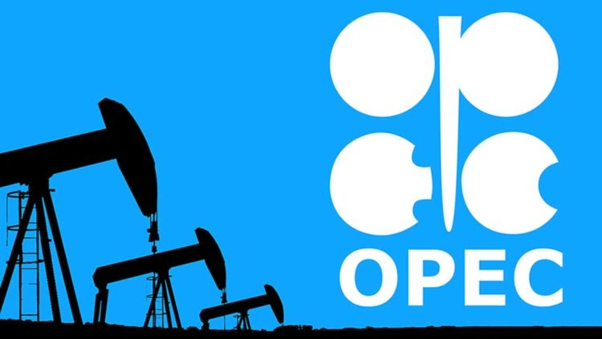
Module 7 · Part 1 · Cournot Competition
Further Examples for Cournot Competition
Oil
However: Includes a cartel (OPEC)
Steel producers
US crude steel production by producer, 2024
Source: worldsteel, company reports. U.S. Steel acquired by Nippon Steel, June 2025
Management 405 · Module 7 · Oligopoly and Game Theory
28
Notes:
Why OPEC is not sued for antitrust: '[i]f the members of OPEC were private companies and not nations, they long ago would have been prosecuted for engaging in illegal price fixing.' However, OPEC member nations have argued that doctrines of sovereign immunity and act of state make them immune from U.S. antitrust prosecution for their otherwise illegal price fixing cartel. Indeed, a federal court decision in 1979 ruled that the actions of OPEC were immune from U.S. antitrust scrutiny because of the doctrine of sovereign immunity (the proposition that the government cannot be sued without its consent).
Source: https://energyfuse.org/should-we-still-be-concerned-about-opec/
Steel pie (updated 2026): shares of US crude steel production 2024, total 79.5 Mt (worldsteel). Nucor 26% (20.7 Mt), Cleveland-Cliffs 20% (~16 Mt - it absorbed BOTH ArcelorMittal USA and AK Steel in 2020, which is why the old chart looks so different), U.S. Steel 13% (10.7 Mt, acquired by Nippon Steel June 2025, still operating as U.S. Steel), Steel Dynamics 13% (10.2 Mt), CMC ~6% (approx., fiscal-year basis), Others ~22% (Gerdau, North Star BlueScope, NLMK USA, SSAB Americas, etc). Sources: worldsteel company rankings 2024; U.S. Steel 10-K segment data; company reports.

Slide 29
Module 7 · Part 1 · Bertrand Competition
Outline of Module 7
1
Collusion and Cartels
2
Cournot Competition
3
Bertrand Competition
Competing by setting prices, and why it can compete profits away
4
Oligopoly with Differentiated Goods
5
Strategic Thinking: Key Concepts
6
Prisoner’s Dilemma, Game of Chicken…
Management 405 · Module 7 · Oligopoly and Game Theory
29

Slide 30
Module 7 · Part 1 · Bertrand Competition
Bertrand Competition
Bertrand assumed that firms choose a price and stand ready to meet all demand at that price
Each firm sets a price that maximizes profits, conditional on the price set by the other firm
Contrast this with the Cournot case, where the game was played on quantities
Management 405 · Module 7 · Oligopoly and Game Theory
30

Slide 31

Module 7 · Part 1 · Bertrand Competition
Bertrand Competition (with Identical Goods)
Assumptions:
▪ Firms make identical products
▪ Firms compete by choosing the price at
which they sell their products
Management 405 · Module 7 · Oligopoly and Game Theory
31

Slide 32
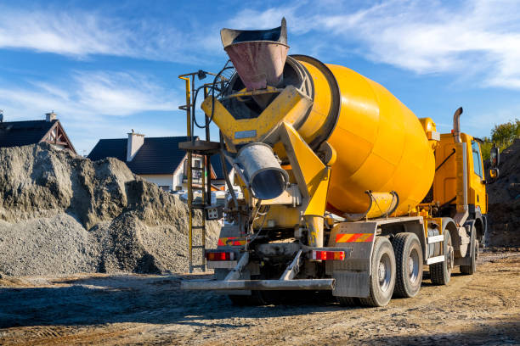
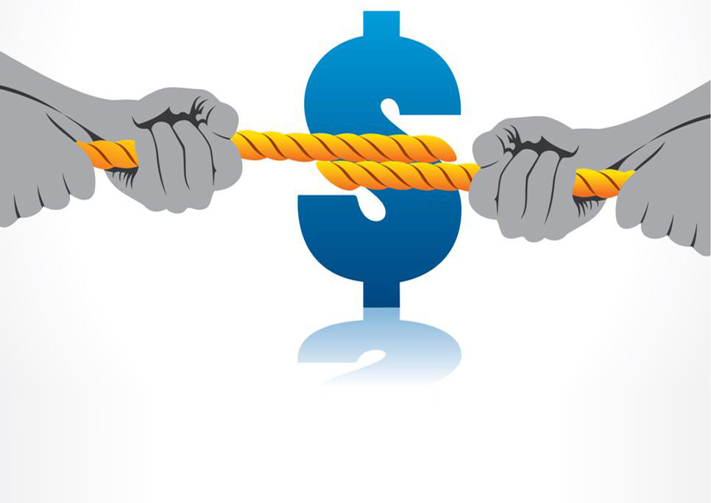
Module 7 · Part 1 · Bertrand Competition
Choose Your Concrete Price
Two competitors, identical good: Concrete
Same marginal cost: MC = $120 per cubic yard
You and your competitor submit a sealed price bid for a huge project
What's your price bid?
Poll Break
Management 405 · Module 7 · Oligopoly and Game Theory
32
Notes:
Updated 2026-08-06 (fact-checked): US ready-mix concrete is quoted per CUBIC YARD, and MC = $120/yd3 matches industry data - materials (cement, aggregates, admixtures) ran $89-96/yd3 in 2023-24 plus roughly $15-25/yd3 delivery (NRMCA benchmarking and monthly surveys). The average US selling price was about $180/yd3 in 2025, so students should bid down from around the market price toward the $120 marginal cost. NOTE: the PollEverywhere answer bands (slide 32) are being updated by Nico to match the new $120 anchor. Sources: NRMCA Performance Benchmarking Survey (Oct 2024); concretefinancialinsights.com; US Concrete 10-K.

Slide 33
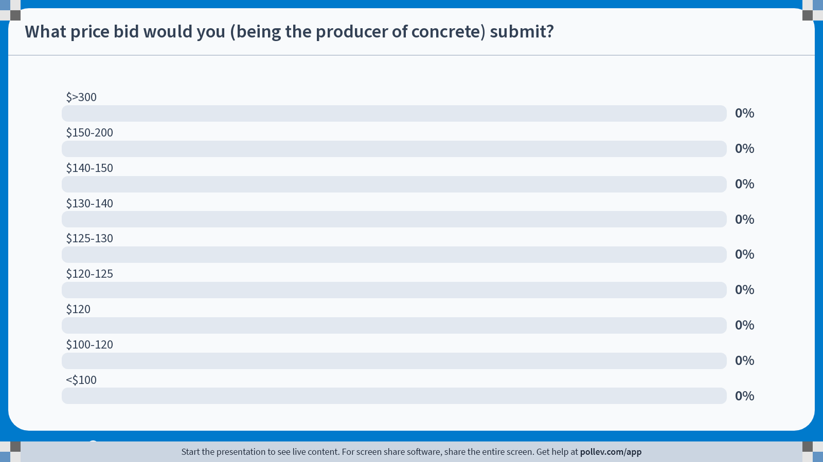
Notes:
Poll Title: Do not modify the notes in this section to avoid tampering with the Poll Everywhere activity.
More info at polleverywhere.com/support
What price bid would you (being the producer of concrete) submit?
https://www.polleverywhere.com/multiple_choice_polls/cPmM4EjskHq9d0maIszSW?state=opened&flow=Default&onscreen=persist

Slide 34
Module 7 · Part 1 · Bertrand Competition
Bertrand Competition
P
Suppose Firms A and B start at a price of $40, where each supplies Q=30
A believes that B will maintain its price. What will A do? How will B respond?
$100
$$P = 100 − Q_{M}$$
$40
Lost by A
$39
Bertrand Equilibrium
Gained by A
→ A and B will continue to lower their price until they reach P = MC
MC
$10
30
60
61
90
100
Q
Management 405 · Module 7 · Oligopoly and Game Theory
34
Notes:
Bertrand assumed that firms choose a price and stand ready to meet all demand at that price. Each firm sets a price that maximizes profits holding constant the price set by the other firm. Contrast this with the Cournot case where the game is played on quantities.
What is the outcome of Bertrand competition? The only equilibrium is P1 = P2 = MC. If, say P2 >= P1 > MC, P2 will undercut by a small amount, so there are no such equilibria. Proof: starting at P1 = P2 = MC, neither firm gains from raising (sells nothing) or cutting (negative profit). And any price above MC invites undercutting — the situation in the figure (both at $40, one drops to $39: it loses the thin strip on its old sales but gains the whole market).
Bertrand with identical goods has a clean solution, but the conditions are rare. A market that came close: online retail of computer chips for home-built CPUs — consumers bought the cheapest chip and prices were approximately marginal cost, with retailers trying to escape via obfuscation (loss-leader ads, add-ons). With differentiated goods, equilibrium prices can stay above marginal cost.

Slide 35
Module 7 · Part 1 · Bertrand Competition
Oligopoly Outcomes: Comparison
P
$100
$$P = 100 − Q_{M}$$
Monopoly Equilibrium
(also collusive/cartel equilibrium)
$55
Cournot Equilibrium
Bertrand Equilibrium
$40
(same as Perfect Competition
when both firms have same MC)
MR
MC
$10
45
60
90
100
Q
Management 405 · Module 7 · Oligopoly and Game Theory
35
Notes:
You can use this graph to understand the welfare consequences of these different forms of competition.
Producer welfare ranks: Perfect Competition = Bertrand < Cournot < Monopoly. Consumer welfare ranks: Perfect Competition = Bertrand > Cournot > Monopoly. Total surplus ranks: Perfect Competition = Bertrand > Cournot > Monopoly.
These last two comparisons (consumer welfare and total surplus decrease with market power) are the reason why the Federal Trade Commission cares about market power.

Slide 36
Module 7 · Part 1 · Bertrand Competition
Comparison of Outcomes: Math (for your reference)
$$P = 100 − Q and MC = 10$$
Monopoly:
$TR = P·Q = (100 − Q)·Q = 100Q − Q^{2}$
$MR = 100 − 2Q$
$MR = MC → 100 − 2Q = 10$
➜ Q = 45, P = 55
Cournot: Q = 60, P = 40
Perfect competition / Bertrand:
$P = MC → 100 − Q = 10$
➜ Q = 90, P = 10
▶ Practice Video “Cournot Competition Math”
Management 405 · Module 7 · Oligopoly and Game Theory
36
Notes:
The algebra behind the comparison chart, all with the same market demand P = 100 − Q and MC = 10. The monopolist (or cartel) sets MR = MC and produces 45 at a price of 55. The Cournot duopoly ends up at 60 and a price of 40 — between monopoly and competition. Bertrand price competition drives the price all the way down to marginal cost: 90 units at a price of 10, the perfectly competitive outcome.

Slide 37
Module 7 · Part 1 · Bertrand Competition
Overview: Cournot vs. Bertrand
Cournot: quantity competition
Bertrand: price competition
Firms set capacity strategically
Firms set price strategically
There isn't a “correct” and an “incorrect” model, they just make different assumptions
Often Bertrand (price) competition in the short run
Cournot (quantity) competition in the long run (e.g., by setting up production capacities)
Management 405 · Module 7 · Oligopoly and Game Theory
37
Notes:
Bertrand with identical goods has a nice solution but the conditions that give rise to this outcome are rare in the real world. A market that was close was the online market for computer chips for consumers that like to build their own CPUs. Consumers bought the cheapest chip. Researchers found that prices were approx. marginal cost. An interesting wrinkle is that computer chip retailers attempted to differentiate their goods through obfuscation: either by advertising an inferior chip as a loss leader and then redirecting the consumer to their website or by offering product add-ons. In a Bertrand model with differentiated goods, there is the potential for the equilibrium price to be above marginal cost.

Slide 38
Module 7 · Part 1 · Differentiated Goods
Outline of Module 7
1
Collusion and Cartels
2
Cournot Competition
3
Bertrand Competition
4
Oligopoly with Differentiated Goods
How differentiation softens price competition
5
Strategic Thinking: Key Concepts
6
Prisoner’s Dilemma, Game of Chicken…
Management 405 · Module 7 · Oligopoly and Game Theory
38

Slide 39
Module 7 · Part 1 · Differentiated Goods
Bertrand Competition with Differentiated Products
So far: We assumed that all firms produce identical products
More common situation: Differentiated products
Pepsi and Coke
Airbus A320 vs. Boeing 737 (medium-range)
Airbus A350 vs. Boeing 787 (long-range)
Setting now:
2 firms producing differentiated products
Management 405 · Module 7 · Oligopoly and Game Theory
39

Slide 40
Module 7 · Part 1 · Differentiated Goods
Bertrand Competition (with Differentiated Goods)
Assumptions:
▪ Firms do not sell identical products. They sell differentiated products
▪ Each firm faces its own demand function!
▪ Each firm simultaneously chooses the price at which it sells its product
Management 405 · Module 7 · Oligopoly and Game Theory
40
Notes:
The three assumptions for Bertrand with differentiated goods: differentiated products, an own demand function for each firm, and prices chosen simultaneously. Why do we need simultaneity? It means neither firm can observe the rival's price before setting its own, and neither can commit to moving first — so the equilibrium is a pair of mutual best responses rather than a leader-follower outcome. It also answers the natural question about the price war: the second mover cannot simply wait and undercut at the last moment, because in this setting there is no last mover. In Part 2 we deliberately break exactly this assumption — commitment is what changes when one player CAN move first.

Slide 41
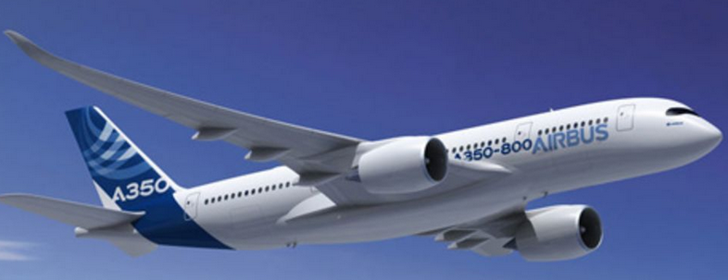
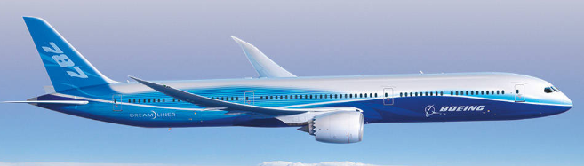
Module 7 · Part 1 · Differentiated Goods
Oligopoly with Differentiated Goods
Oligopoly on long-range aircraft:
Airbus A350 (Firm A)
Boeing 787 (Firm B)
Interdependent demand:
$$Q_{A} = 400 − 2P_{A} + P_{B}$$
$$Q_{B} = 400 − 2P_{B} + P_{A}$$
substitutes
Note: Now we have 2 demand functions! (Differentiated products)
Same marginal cost (all in $Million):
$${MC}_{A} = {MC}_{B} = 200$$
▶ Optional Advanced Practice Video: “Bertrand Competition with Differentiated Goods – Math”
Management 405 · Module 7 · Oligopoly and Game Theory
41

Slide 42
Module 7 · Part 1 · Differentiated Goods
Reaction Function: Airbus' Reaction to Boeing's Price (I)
P
Airbus assumes that Boeing charges P_{B} = 200
200
Airbus' (inverse) Demand
$P_{A} = 200 − 0.5·Q_{A} + 0.5·P_{B}$
$= 200 − 0.5·Q_{A} + 100$
$= 300 − 0.5·Q_{A}$
→ Airbus' optimal price response is P_{A} = 250
300
A higher price $P_{B}$ increases demand for Airbus
250
200
MC
$${MR}_{A}$$
100
300
600
Q
Management 405 · Module 7 · Oligopoly and Game Theory
42
Notes:
Same two-step logic as in the Cournot case, but now in prices. Step 1: fix Boeing's price at PB=200 and substitute it into Airbus' demand, giving the inverse demand PA = 300 − 0.5·QA. Step 2: maximize profit as usual (MR = MC with MC = 200): the optimal quantity is 100 and the optimal price response is PA = 250. Note the difference to Cournot: price responds POSITIVELY to price increases by the other firm.

Slide 43
Module 7 · Part 1 · Differentiated Goods
Reaction Function: Airbus' Reaction to Boeing's Price (II)
P
Airbus assumes that Boeing charges P_{B} = 400
400
400
Airbus' (inverse) Demand
$P_{A} = 200 − 0.5·Q_{A} + 0.5·P_{B}$
$= 400 − 0.5·Q_{A}$
→ Airbus' optimal price response is P_{A} = 300
300
MC
200
Higher demand for Airbus because $P_{B}$ has increased
$${MR}_{A}$$
Previous demand at $P_{B} = 200$
200
400
800
Q
Management 405 · Module 7 · Oligopoly and Game Theory
43
Notes:
Same two-step logic as in the Cournot case, but now in prices. Step 1: fix Boeing's price at PB=400 and substitute it into Airbus' demand, giving the inverse demand PA = 400 − 0.5·QA. Step 2: maximize profit as usual (MR = MC with MC = 200): the optimal quantity is 200 and the optimal price response is PA = 300. Note the difference to Cournot: price responds POSITIVELY to price increases by the other firm.

Slide 44
Module 7 · Part 1 · Differentiated Goods
Equilibrium Prices
Boeing's reaction function
$P_{B} = 200 + 0.25·P_{A}$
Airbus' reaction function
$P_{A} = 200 + 0.25·P_{B}$
300
267
250
Reaction point (II)
Airbus' Price ($P_{A}$)
200
Equilibrium
$P_{A} = P_{B} = 267$
150
Reaction point (I)
Starting point: Airbus contemplates charging P_{A} = 150
200
267
400
Boeing's Price ($P_{B}$)
Management 405 · Module 7 · Oligopoly and Game Theory
44
Notes:
Price responds POSITIVELY to price increases by the other firm. Note that this is the opposite of Cournot, where Firm A wants to produce less if firm B produces more. The two reaction functions — Airbus' PA = 200 + 0.25·PB and Boeing's mirror image — intersect at the equilibrium PA = PB = 267. Starting from PA = 150, the contemplated responses move both firms toward the equilibrium.

Slide 45
Module 7 · Part 1 · Differentiated Goods
Play This Game on Bruinlearn
Under Module 7 / In-Class Content
You can choose Boeing's price and observe Airbus's reaction (price)
You also see the profits of both companies
You can also change the demand functions (make payoffs asymmetric)
BruinLearn → Module 7 / In-Class Content
Management 405 · Module 7 · Oligopoly and Game Theory
45

Slide 46
Module 7 · Part 1 · Differentiated Goods
Take-Aways: Oligopoly with Differentiated Goods
The two firms produce differentiated products, so each has its own demand curve
However, each firm's demand curve is affected by the other firm's price
When the competitor raises its price, the optimal response is for the other firm to also raise its price
In equilibrium, neither firm has an incentive to deviate
If MC are different, the optimal prices will be different for the two firms
Note: Math on this problem is optional (will not be in final exam)
▶ Optional Advanced Practice Video: “Bertrand Competition with Differentiated Goods – Math”
Management 405 · Module 7 · Oligopoly and Game Theory
46

Slide 47
Module 7 · Part 1 · Differentiated Goods
Oligopoly: Concluding Discussion
If you could pick one type of Oligopoly competition for your firm, which would you choose? Why?
In which oligopoly case can you improve your product?
What is the effect of improving your product?
Discussion Break
Management 405 · Module 7 · Oligopoly and Game Theory
47

Slide 48
Module 7 · Part 2 · Key Concepts
Outline of Module 7
1
Collusion and Cartels
2
Cournot Competition
3
Bertrand Competition
4
Oligopoly with Differentiated Goods
5
Strategic Thinking: Key Concepts
Best responses, dominant strategies, and Nash equilibrium
6
Prisoner’s Dilemma, Game of Chicken…
Management 405 · Module 7 · Oligopoly and Game Theory
48

Slide 49
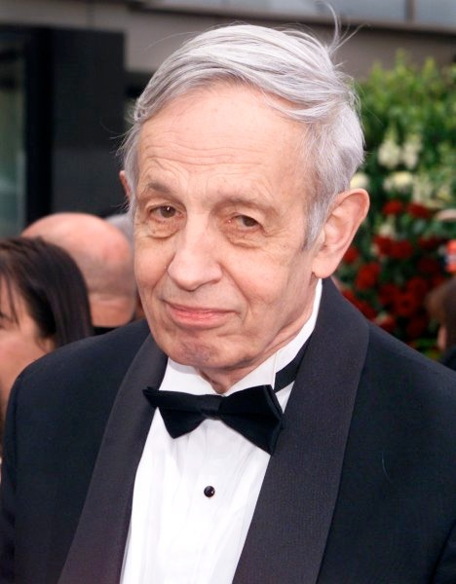
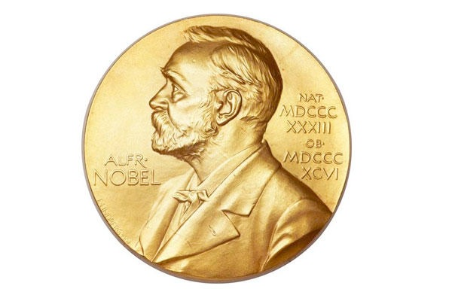

Module 7 · Part 2 · Key Concepts
What Is Game Theory?
Branch of economics concerned with interdependent situations
The outcome of a participant's choice depends critically on the actions of other participants
Game theory has transformed not only economics, but also the study of war, of business strategy, and of biological systems
Father of Game Theory: John Nash
1994 Nobel Prize in Economics
Inspired the movie “A Beautiful Mind”
John Nash (1928–2015)
Management 405 · Module 7 · Oligopoly and Game Theory
49
Notes:
In biology, game theory is used to explain how organisms behave when their success depends on the actions of others. It helps clarify why an organism might cooperate, compete, form alliances, or adopt particular signaling or mating strategies. Classic examples include the evolution of cooperation, predator–prey interactions, and stable ratios of aggressive vs. passive behavioral types within a species.

Slide 50
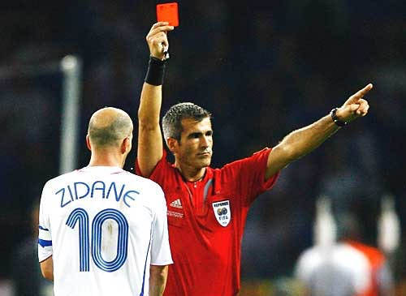
Module 7 · Part 2 · Key Concepts
A Warm-Up Game
I brought 5 yellow and 5 red cards
But this is not about soccer…
Instead:
I distribute the 5 yellow cards to students
Suppose I get $100 from the Dean for each red-yellow pair that I take back to her after class
You can ‘sell’ your yellow card back to me
What's your asking price for your yellow card?
Management 405 · Module 7 · Oligopoly and Game Theory
50

Slide 51
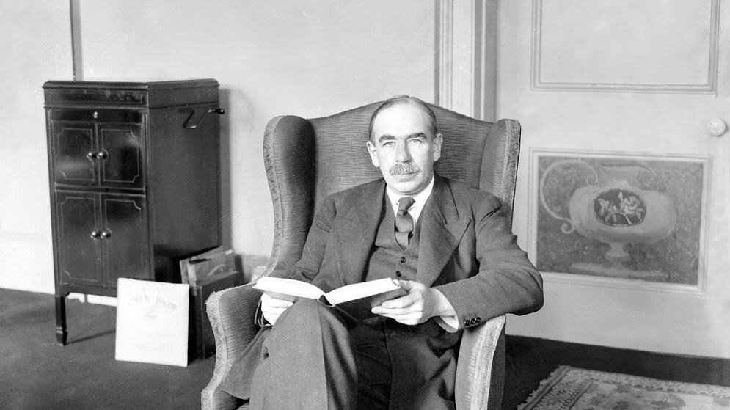
Module 7 · Part 2 · Key Concepts
Strategic Thinking: The Beauty Contest
Prominent game in newspapers in the 1930s:
Get a reward if you select the face that is the most popular among others (not the one that you find most attractive)
John Maynard Keynes (1936) used it as analogy
John Maynard Keynes
Management 405 · Module 7 · Oligopoly and Game Theory
51

Slide 52
Module 7 · Part 2 · Key Concepts
Strategic Thinking: Numerical Beauty Contest
Numerical application:
All participants are asked to pick a number between 0 and 100
Winner: the number that is closest to 2/3 of the average of all numbers submitted
Poll Break
Management 405 · Module 7 · Oligopoly and Game Theory
52

Slide 53
Module 7 · Part 2 · Key Concepts
Poll
[ PHASE 3 — PollEverywhere slide, spliced from source deck ]
Management 405 · Module 7 · Oligopoly and Game Theory
53

Slide 54
Module 7 · Part 2 · Key Concepts
Key Concepts of Game Theory
Strategic behavior by all participants
Optimization: maximize individual payoff
To study strategic behavior:
Best response: optimal decision given what the other player does
Dominant strategy: optimal action no matter what the other player does
Nash equilibrium: «intersection of best responses»
Position from which neither player would find it advantageous to deviate (e.g., Cournot equilibrium)
Management 405 · Module 7 · Oligopoly and Game Theory
54

Slide 55
Module 7 · Part 2 · Classic Games
Outline of Module 7
1
Collusion and Cartels
2
Cournot Competition
3
Bertrand Competition
4
Oligopoly with Differentiated Goods
5
Strategic Thinking: Key Concepts
6
Prisoner’s Dilemma, Game of Chicken…
Classic games and what they teach about business strategy
Management 405 · Module 7 · Oligopoly and Game Theory
65

Slide 56
Module 7 · Part 2 · Classic Games
Prisoner's Dilemma: Setup and Payoffs
Prisoner 2
Silent
Betray
Silent
-1 , -1
-10 , 0
Prisoner 1
Betray
0 , -10
-8 , -8
Payoffs to (Prisoner 1, Prisoner 2)
Interpretation of payoffs:
Negative values, because they indicate years in prison
Management 405 · Module 7 · Oligopoly and Game Theory
56
Notes:
We start with the payoff table. Payoffs to the player on the left (Prisoner 1) are blue, and shown on the left. Payoffs to the player on top of the matrix (Prisoner 2) are gold, and shown on the right.

Slide 57
Module 7 · Part 2 · Classic Games
Prisoner's Dilemma: Strategy of Prisoner 1
Prisoner 2
Silent
Betray
Silent
-1 , -1
-10 , 0
Prisoner 1
Betray
0 , -10
-8 , -8
Payoffs to (Prisoner 1, Prisoner 2)
Interpretation of arrows:
Prisoner 1 picks his best response to Prisoner 2's (hypothetical) choices
Management 405 · Module 7 · Oligopoly and Game Theory
57
Notes:
This slide analyzes the strategy of Prisoner 1. Here we blind out the payoffs for Prisoner 2 because Prisoner 1 only cares about his own payoffs when deciding on a strategy. The arrows for Prisoner 1 (in general, for the player to the left of the matrix) are drawn vertically.

Slide 58
Module 7 · Part 2 · Classic Games
Prisoner's Dilemma: Strategy of Prisoner 2
Prisoner 2
Silent
Betray
Silent
-1 , -1
-10 , 0
Prisoner 1
Betray
0 , -10
-8 , -8
Payoffs to (Prisoner 1, Prisoner 2)
Interpretation of arrows:
Prisoner 2 picks his best response to Prisoner 1's (hypothetical) choices
Management 405 · Module 7 · Oligopoly and Game Theory
58
Notes:
And now we blind out the payoffs for Prisoner 1 because Prisoner 2 only cares about his own payoffs when deciding on a strategy. The arrows for Prisoner 2 (in general, the player on top of the matrix) are drawn horizontally.

Slide 59
Module 7 · Part 2 · Classic Games
Prisoner's Dilemma: Equilibrium
Prisoner 2
Silent
Betray
Silent
-1 , -1
-10 , 0
Prisoner 1
Nash Equilibrium
Betray
0 , -10
-8 , -8
Payoffs to (Prisoner 1, Prisoner 2)
Both players' dominant strategy is to betray, so individual optimization produces a “socially” sub-optimal outcome
Management 405 · Module 7 · Oligopoly and Game Theory
59
Notes:
In the Nash Equilibrium, neither player has the incentive to deviate: If Prisoner 1 betrays, then Prisoner 2 also wants to betray, and vice-versa.

Slide 60
Module 7 · Part 2 · Classic Games
Ways to Solve the Dilemma
Communication:
What would a lawyer do?
External solutions:
What would the Mafia do?
Commitment
Moral rules (guilt/“conscience”)
Repetition
Podcast (next slide)
Management 405 · Module 7 · Oligopoly and Game Theory
60

Slide 61
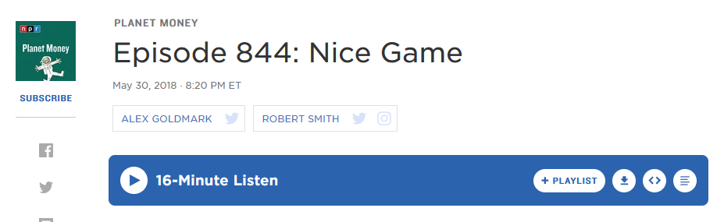
Module 7 · Part 2 · Classic Games
Podcast on Prisoner's Dilemma
What's the experiment that Bob Axelrod ran in the 1980s?
What was the winning strategy?
Management 405 · Module 7 · Oligopoly and Game Theory
61

Slide 62
Module 7 · Part 2 · Classic Games
Fair Play vs. “Dirty” Play
Team 2
Play fair
Play dirty
Play fair
0.5 , 0.5
0.3 , 0.7
Team 1
Nash Equilibrium
Play dirty
0.7 , 0.3
0.5 , 0.5
Payoffs to (Team 1, Team 2)
Interpretation of payoffs:
Teams' odds of winning
Each team's dominant strategy is to play dirty
Management 405 · Module 7 · Oligopoly and Game Theory
62

Slide 63
Module 7 · Part 2 · Classic Games
Game Theory and Trade Wars
In a trade war, each country's dominant strategy is to set high tariffs
China
Low Tariffs
High Tariffs
Low Tariffs
20 , 20
13 , 24
US
Nash Equilibrium
High Tariffs
24 , 13
15 , 15
Payoffs to (US, China)
Interpretation of payoffs:
Countries' real GDP ($ trillion, price-adjusted)
2025–26 tariff war: US average tariff on Chinese goods ≈ 48%; China's on US goods ≈ 32% (PIIE)
Management 405 · Module 7 · Oligopoly and Game Theory
63
Notes:
The payoff numbers are stylized, but they are calibrated to real magnitudes. Interpretation of payoffs: real GDP in $ trillion. Actual 2025 nominal GDP: US ≈ $30.6 trillion, China ≈ $19.4 trillion (IMF World Economic Outlook, Oct 2025).
Where we actually are: after the 2025 tariff escalations and the partial truces (Geneva, May 2025; Korea, Nov 2025), the average US tariff on Chinese imports is ≈ 47.5% and China's average tariff on US imports ≈ 31.9% (PIIE US–China trade war tariff tracker, Nov 2025) — i.e., the high-tariff / high-tariff cell.
Estimated costs behind the payoff gaps: the 2025 tariff actions are estimated to reduce long-run US GDP by roughly 0.3–0.7% (Yale Budget Lab; Tax Foundation), on the order of $100–200B per year; for China, estimates run from 0.5 to 2.5 percentage points off GDP growth over 2025–27 depending on escalation (EIU).
The game's structure matches the evidence: a unilateral tariff shifts some surplus to the imposing country (the 24 vs. 13 cells), but when both retaliate, both end up worse off (15, 15) than under mutual low tariffs (20, 20) — the prisoner's-dilemma logic.

Slide 64
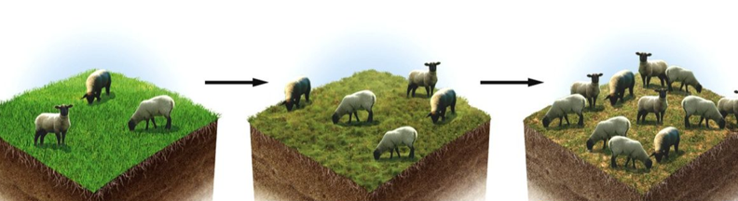
Module 7 · Part 2 · Classic Games
General Lesson: Collective Action Problem
Acting selfishly can lead to socially suboptimal outcomes
Also holds in situations with more than 2 players
Known as “tragedy of the commons”
▪ Stark contrast with “invisible hand” principle (Adam Smith)
Management 405 · Module 7 · Oligopoly and Game Theory
64

Slide 65
Module 7 · Part 2 · Classic Games
The Game of Chicken
You and your arch-enemy drive towards each other on a narrow street
You
Similar game in “Rebel Without a Cause”
avoid
drive on
avoid
0 , 0
-10 , 10
Arch enemy
2 Nash Equilibria
drive on
10 , -10
-100 , -100
Payoffs to (Arch enemy, You)
Real world examples:
Entry into a market that can only sustain one firm profitably (natural monopoly)
The Cold War (next slide)
Management 405 · Module 7 · Oligopoly and Game Theory
65

Slide 66
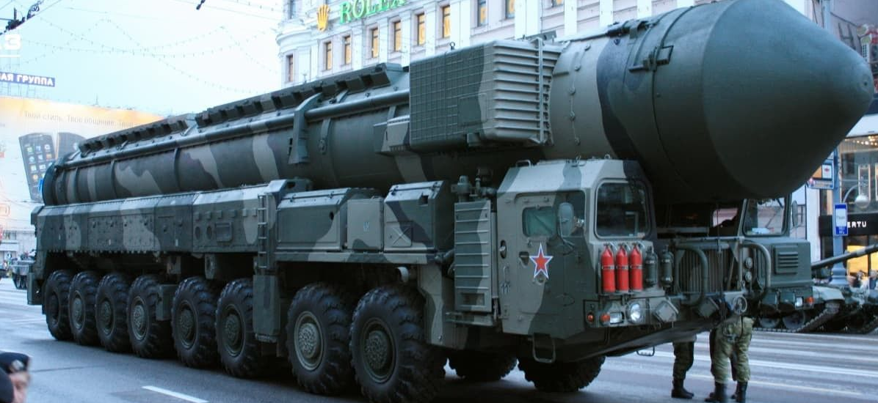
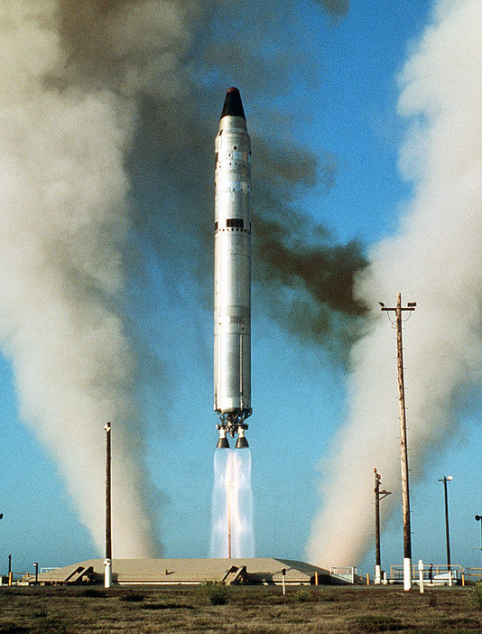
Module 7 · Part 2 · Classic Games
The Cold War and M.A.D.
Why did none of the two super-powers use nukes?
Mutually Assured Destruction (M.A.D.)
USSR
Don't use nuclear weapons
Use nuclear weapons
No nukes
0 , 0
-20 , 10
USA
2 Nash Equilibria
Use nukes
10 , -20
-100 , -100
Payoffs to (USA, USSR)
Management 405 · Module 7 · Oligopoly and Game Theory
66
Notes:
Picture left: US Titan II nuclear missile. Picture right: Soviet Union nuclear warhead.

Slide 67
Module 7 · Part 2 · Classic Games
Group Work
How does the payoff table change under M.A.D.?
“Doomsday device” (also explained by Dr. Strangelove)
USSR
Don't use nuclear weapons
Use nuclear weapons
No nukes
0 , 0
(Cell impossible due to M.A.D.)
USA
Use nukes
(Cell impossible due to M.A.D.)
-100 , -100
Payoffs to (USA, USSR)
The world came very close to destruction: Documentary
Discussion Break
Management 405 · Module 7 · Oligopoly and Game Theory
67
Notes:
See here for an illustration using a decision tree: https://www.spaceship.com.au/learn/game-theory-cold-war/
Documentary: “The Man Who Saved the World”: Vasili Arkhipov.

Slide 68
Module 7 · Part 2 · Classic Games
Commitment and Strategy
Note that M.A.D. represents a commitment (to retaliate)
USSR
Don't use nuclear weapons
Use nuclear weapons
No nukes
0 , 0
(Cell empty due to USA's commitment to retaliate)
USA
Use nukes
(Cell empty due to USSR's commitment to retaliate)
-100 , -100
Payoffs to (USA, USSR)
(Much) more on commitment in your Strategy class!
Crucial: Is the player's “commitment” credible?
Tickets →
Management 405 · Module 7 · Oligopoly and Game Theory
68

Slide 69
Module 7 · Part 2 · Classic Games
Penalty Kicks: Find the (Pure-Strategy) Nash Equilibrium
Note:
Pure Strategy: Each player picks either “Left” or “Right” (as in all games we've seen thus far)
Mixed Strategy: Players can also assign probabilities with which they pick Left or Right (not relevant for our class)
Goalie
Left
Right
Left
-1 , 1
1 , -1
Kicker
Right
1 , -1
-1 , 1
Payoffs to (Kicker, Goalie)
Poll Break
Management 405 · Module 7 · Oligopoly and Game Theory
69

Slide 70
Module 7 · Part 2 · Classic Games
Poll
[ PHASE 3 — PollEverywhere slide, spliced from source deck ]
Management 405 · Module 7 · Oligopoly and Game Theory
70

Slide 71
Module 7 · Part 2 · Classic Games
Penalty Kicks: Solution
Goalie
Left
Right
Left
-1 , 1
1 , -1
Kicker
Right
1 , -1
-1 , 1
Payoffs to (Kicker, Goalie)
There is no (pure-strategy) Nash Equilibrium
Management 405 · Module 7 · Oligopoly and Game Theory
71
Notes:
This is a nice illustration of what “equilibrium” means: given that one player goes “right”, the other one also wants to go “right” – but that's not the case here. Goalie and Kicker never want to be in the same cell.

Slide 72
Module 7 · Part 2 · Classic Games
Find the (Pure-Strategy) Nash Equilibrium
Pepsi
Advertise
Don't Advertise
Advertise
150 , 150
450 , -75
Coke
Don't Advertise
-75 , 450
225 , 225
Payoffs to (Coke, Pepsi)
Interpretation of payoffs:
Firms' profits
Poll Break
Management 405 · Module 7 · Oligopoly and Game Theory
72
Notes:
The answer is 1. Both advertise, and make lower profits than if they could coordinate on not advertising. This is just like the prisoner's dilemma.

Slide 73
Module 7 · Part 2 · Classic Games
Poll
[ PHASE 3 — PollEverywhere slide, spliced from source deck ]
Management 405 · Module 7 · Oligopoly and Game Theory
73

Slide 74
Module 7 · Part 2 · Classic Games
Pepsi vs. Coke: Solution
Pepsi
Advertise
Don't Advertise
Advertise
150 , 150
450 , -75
Coke
Don't Advertise
-75 , 450
225 , 225
Payoffs to (Coke, Pepsi)
Interpretation of payoffs:
Firms' profits
Both advertise — lower profits than if they could coordinate
Management 405 · Module 7 · Oligopoly and Game Theory
74
Notes:
The answer is 1. Both advertise, and make lower profits than if they could coordinate on not advertising. This is just like the prisoner's dilemma.

Slide 75
Module 7 · Part 2 · Classic Games
Game Theory on TV: Split or Steal?
[ PHASE 3 — video slide, spliced from source deck ]
Management 405 · Module 7 · Oligopoly and Game Theory
75

Slide 76
Module 7 · Part 2 · Classic Games
“Split or Steal”: Payoff Matrix
We assume that good reputation (when splitting) is worth £5k (while bad reputation is worth £0)
We round the total jackpot to £100k
Sarah
Split
Steal
Split
£55 , £55
£5 , £100
Steven
2 Nash Equilibria
Steal
£100 , £5
£0 , £0
Payoffs to (Steven, Sarah)
Management 405 · Module 7 · Oligopoly and Game Theory
76

Slide 77
Module 7 · Part 2 · Classic Games
Split or Steal: Coordination?
[ PHASE 3 — video slide, spliced from source deck ]
Management 405 · Module 7 · Oligopoly and Game Theory
77

Slide 78
Module 7 · Part 2 · Classic Games
Poll
[ PHASE 3 — PollEverywhere slide, spliced from source deck ]
Management 405 · Module 7 · Oligopoly and Game Theory
78

Slide 79
Module 7 · Part 2 · Classic Games
Split or Steal
[ PHASE 3 — video slide, spliced from source deck ]
Management 405 · Module 7 · Oligopoly and Game Theory
79

Slide 80
Module 7 · Part 2 · Classic Games
Commitment and Strategy
If Steven could commit to Steal, what would be Sarah's optimal response?
Sarah
Split
Steal
Split
(Cell impossible due to Steven's commitment)
(Cell impossible due to Steven's commitment)
Steven
Steal
£100 , £5
£0 , £0
Payoffs to (Steven, Sarah)
(Much) more on this in your Strategy class!
Crucial: Is the player's “commitment” credible?
Management 405 · Module 7 · Oligopoly and Game Theory
80

Slide 81
Module 7 · Part 2 · Classic Games
“Split or Steal”: Payoff Matrix
Nick credibly argues that he will steal. Let's assume he gets “satisfaction” = 10 from stealing and seriously plans to share 50-50
Good reputation for splitting is still worth 5
Ibrahim believes that Nick will share winnings with probability p > 0
Ibrahim
Split
Steal
Split
£55 , £55
£5 , £100
Nick
Steal
£60* , p×£50
£10 , £0
Payoffs to (Nick, Ibrahim)
*Assuming that payoff is shared after stealing. Thus, payoff = 0.5×100 + 10
Management 405 · Module 7 · Oligopoly and Game Theory
81
Notes:
Video that will be shown in Strategy: http://www.youtube.com/watch?v=S0qjK3TWZE8

Slide 82
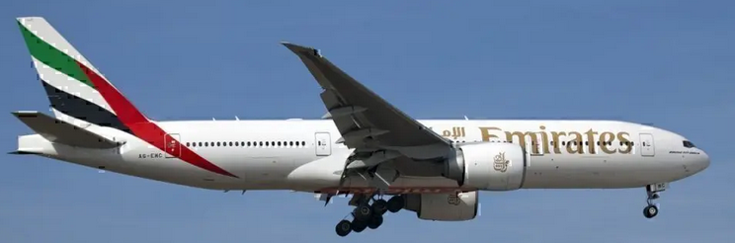
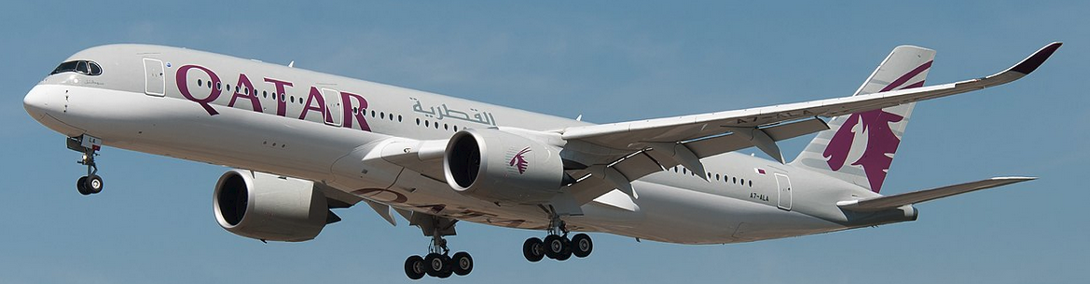
Module 7 · Part 2 · Classic Games
Boeing vs. Airbus: Entry Game
2 firms: Boeing and Airbus
One type of product: Ultra-long-range (ULR) aircraft
Decision: produce or not produce
Boeing: incumbent (777-200LR)
Airbus: must decide whether to enter (A350 ULR)
Analyze the situation with and without subsidies
Management 405 · Module 7 · Oligopoly and Game Theory
82
Notes:
Some background on the 777-200LR, in case it comes up: https://aeronauticsonline.com/why-it-failed-boeing-777-200lr/

Slide 83
Module 7 · Part 2 · Classic Games
No Subsidy Case
Airbus
Interpretation of payoffs:
Annual profits from ULR aircraft (in $B)
Produce
Don't Produce
Produce
-1 , -1
5 , 0
Boeing
Don't Produce
0 , 5
0 , 0
Payoffs to (Boeing, Airbus)
Boeing is already incumbent. So we're initially in this Nash equilibrium
Management 405 · Module 7 · Oligopoly and Game Theory
83

Slide 84
Module 7 · Part 2 · Classic Games
Subsidy Case
EU pays $2B to Airbus if they produce
Airbus
Produce
Don't Produce
Produce
-5 , 1
5 , 0
Boeing
Don't Produce
0 , 7
0 , 0
Payoffs to (Boeing, Airbus)
Unique Nash equilibrium in the EU-only subsidy case
Management 405 · Module 7 · Oligopoly and Game Theory
84

Slide 85
Module 7 · Part 2 · Classic Games
Subsidy in Both EU and US
US now also pays $2B to Boeing if they produce
Airbus
Produce
Don't Produce
Produce
1 , 1
7 , 0
Boeing
Don't Produce
0 , 7
0 , 0
Payoffs to (Boeing, Airbus)
Unique Nash equilibrium in the EU+US subsidy case
Management 405 · Module 7 · Oligopoly and Game Theory
85

Slide 86
Module 7 · Recap
Recap of Module 7 (see Video on BL)
Oligopoly
Game Theory
Competition with homogenous products:
Cournot: Firms compete on quantity. Positive profits
Equilibrium = intersection of the reaction functions
Bertrand: Firms compete on price. Zero profit if both have same MC
Price wars → same outcome as perfect competition (if same MC)
Competition with differentiated products:
The two products are imperfect substitutes (differentiated)
Bertrand: Each firm sets price for its differentiated product
If one firm sets a higher price, the other firm also reacts by raising its price
Equilibrium = intersection of the reaction functions
Strategic thinking: Anticipate other player's reaction
Strategy: Optimized reaction to each action by other player
Use payoff tables
Dominant Strategy
Nash Equilibrium
Management 405 · Module 7 · Oligopoly and Game Theory
86

Slide 87
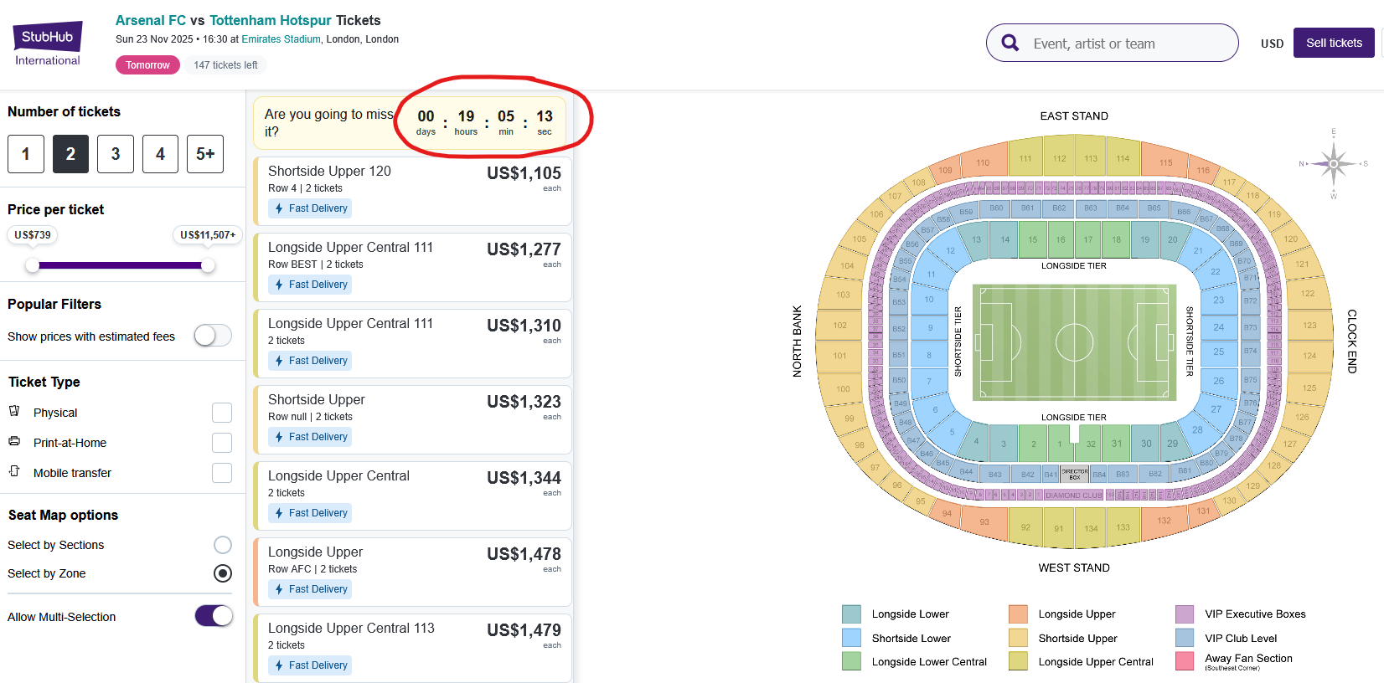
Module 7 · Part 2 · Commitment
Commitment in Selling Tickets
Management 405 · Module 7 · Oligopoly and Game Theory
87

Slide 88
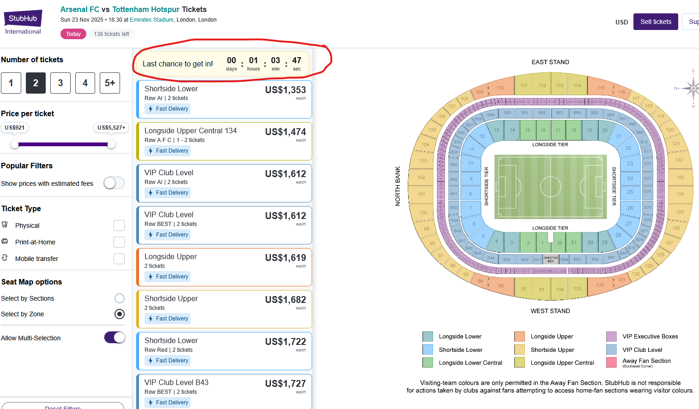
Module 7 · Part 2 · Commitment
Commitment in Selling Ticket Sales
No sign of falling prices as the game comes closer. Why?
← Back
Management 405 · Module 7 · Oligopoly and Game Theory
88

